Slide 1
Web Programming Language
Week 7 Dom Manipulation

Slide 2
JS, JQuery and the DOM
The Document Object Model
Manipulating the DOM
Navigating the DOM

Slide 3
DOM?
The DOM is a structured model of a webpage. While the browser parses a version of the document, the DOM provides a neutral interface for scripts to dynamically access and change the content, structure and style of the document.

Slide 4
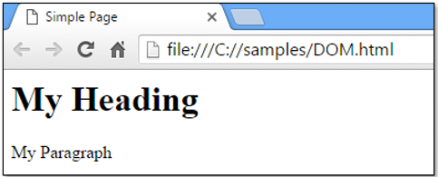
DOM?
<html> <head> <title>Simple Page</title> </head> <body> <div class="simple"> <h1>My Heading</h1> <p>My Paragraph</p> </div> </body> </html>

Slide 5
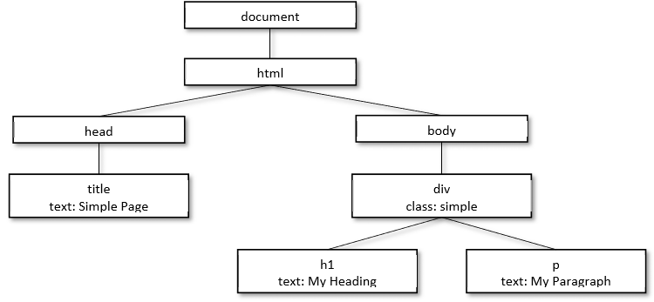
DOM?

Slide 6
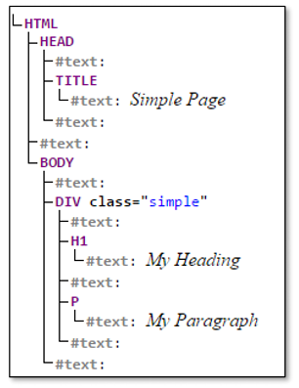
DOM?

Slide 7
text()
Return (OR CHANGE) contents of an element
<script> $(document).ready(function(){ $("#button").click(function(){ alert($("#myparagraph").text()); }); }); </script>

Slide 8
text()
<script> $(document).ready(function(){ $("#button").click(function(){ $("#myparagraph").text(“Changed the text to this”); }); }); </script>

Slide 9
html()
<script> $(document).ready(function(){ $("#button").click(function(){ alert($("#myparagraph").text()); alert($("#myparagraph").html()); }); }); </script> <p id=”myparagraph”><strong>Some text</strong></p>

Slide 10
html()
<script> $(document).ready(function(){ $("#myparagraph").html(“<strong>Hello World</strong>”); }); </script> <p id=”myparagraph”>Hello World</p>

Slide 11
val()
<script> $(document).ready(function(){ $("#submit").click(function(){ if($("#pass1").val().length < 8) { alert(“Password must be at least 8 letters long”); } }); }); </script>

Slide 12
attr()
<script> $(document).ready(function(){ $("#submit").click(function(){ $("#mylink").attr({ "href" : "http://www.google.com", "title" : "Google" }); }); }); </script>

Slide 13
Add elements to a page
Adding to a Page
before() | Adds content before the specified element
after() | Adds content after the specified element
prepend() | Adds content at the start of the specified element
append() | Adds content at the end of the specified element

Slide 14

Add Elements to a Page
<html><head><title>Add</title> <script src="http://ajax.googleapis.com/ajax/libs/jquery/1.8.3/jquery.min.js"></script> <script> $(document).ready(function() { $('#mydiv').before("BEFORE"); $('#mydiv').after("AFTER"); $('#mydiv').prepend("PREPEND"); $('#mydiv').append("APPEND"); }); </script> </head><body> <div id="mydiv">Original Text</div> </body></html>

Slide 15
Removing Elements
Check out:-
remove()
And
empty()

Slide 16
Adding Class
<script> $(document).ready(function(){ $(“#mydiv”).addclass(“subheading”); }); </script>
N.B. removeclass()

Slide 17
css()
<script> $(document).ready(function(){ $("button").click(function(){ $("p").css("background-color","green"); }); }); </script>

Slide 18
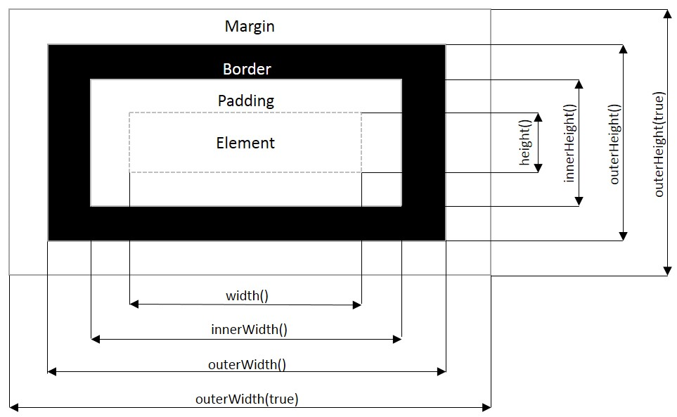
The Box Model

Slide 19
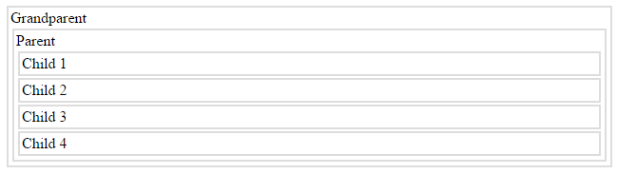
Navigating the DOM
<html><head> <style> .box { display: block; border: 2px solid #ddd; padding: 2px; margin: 2px; } </style> </head><body> <div class="box grandparent" id="grandparent">Grandparent <div class="box" id="parent">Parent <div class="box" id="child1">Child 1</div> <div class="box" id="child2">Child 2</div> <div class="box" id="child3">Child 3</div> <div class="box" id="child4">Child 4</div> </div> </div> </body></html>

Slide 20
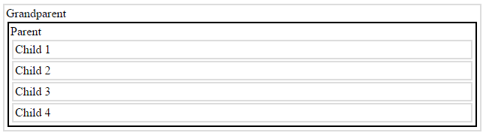
parent()
<script> $(document).ready(function() { $('#child1').parent().css({"border":"2px solid black"}); }); </script>

Slide 21
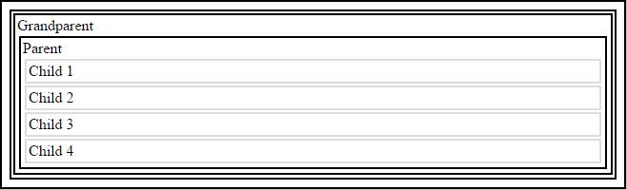
parents()
<script> $(document).ready(function() { $('#child1').parents().css({"border":"2px solid black"}); }); </script>

Slide 22
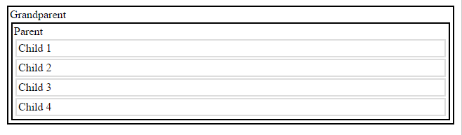
parentsUntil()
<script> $(document).ready(function() { $('#child1').parentsUntil("body").css({"border":"2px solid black"}); }); </script>

Slide 23
Particular Parents?
<script> $(document).ready(function() { $('#child1').parents("div").css({"border":"2px solid black"}); }); </script>

Slide 24
children()
<script> $(document).ready(function() { $('#grandparent').children().css({"border":"2px solid black"}); }); </script>

Slide 25
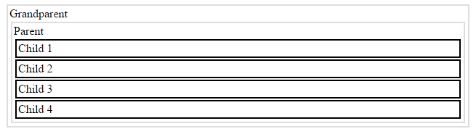
More children()
<script> $(document).ready(function() { $('#grandparent').children().children().css({"border":"2px solid black"}); }); </script>

Slide 26
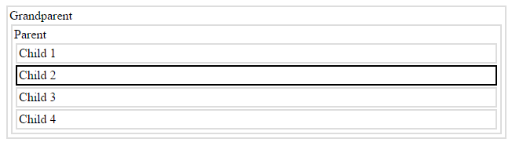
find()
<script> $(document).ready(function() { $('#grandparent').find("#child2").css({"border":"2px solid black"}); }); </script>

Slide 27
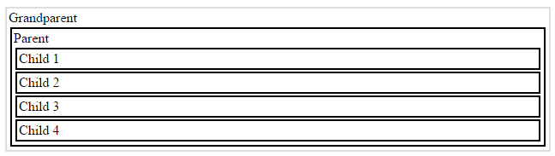
find(*)
<script> $(document).ready(function() { $('#grandparent').find("*").css({"border":"2px solid black"}); }); </script>

Slide 28
More traversal!
Traversing Across the DOM
siblings() | Identifies all other elements with the same parent
next() | Identifies the next element with the same parent
nextAll() | Identifies all subsequent elements with the same parent
nextUntil() | Identifies all subsequent elements with the same parent, until one that satisfies a specified selector
prev() | Identifies the previous element with the same parent
prevAll() | Identifies all previous elements with the same parent
prevUntil() | Identifies all previous elements with the same parent, until one that satisfies a specified selector.

Slide 29
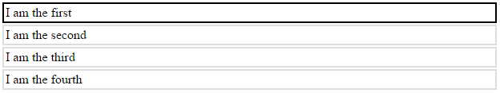
first()
<script> $(document).ready(function() { $('div').first().css({"border":"2px solid black"}); }); </script>

Slide 30
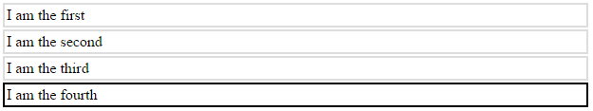
last()
<script> $(document).ready(function() { $('div').last().css({"border":"2px solid black"}); }); </script>

Slide 31
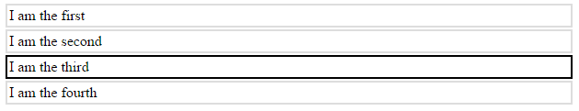
eq()
<script> $(document).ready(function() { $('div').eq(2).css({"border":"2px solid black"}); }); </script>

Slide 32
Key Points
The Document Object Model, or DOM, represents the structure of a webpage with each element on the page an object that are related in a tree structure.
JQuery offers a variety of functions that make manipulating the DOM straightforward.
Existing DOM element can be changed, in terms of their text, their HTML, the values and their attributes.
New elements can be added to the DOM, and elements can be removed.
The DOM can be navigated, once a selector has been targeted, JQuery makes it easy to move up, down or across the tree to move to another element.

Slide 33
Lab Challenge
Continue to make your form validation more ‘beautiful’
Create an attractive form to create an “appointment”
The appointment should have a Date, Time, Title, Description
When the form is submitted, remove the form and add the view created last week, this time adding in the appointment to the appropriate day.

